Slide 1
Hierarchical Clustering
What it is?
python implementation
Use cases

Slide 2
What it is
Hierarchical clustering is a type of unsupervised machine learning algorithm used to cluster unlabeled data points.
Like K-means clustering, hierarchical clustering also groups together the data points with similar characteristics.
In some cases the result of hierarchical and K-Means clustering can be similar.
One of the benefits of hierarchical clustering is that you don't need to already know the number of clusters k in your data in advance.
implementation of hierarchical clustering is provided in the SciPy package.
Sadly, there doesn't seem to be much documentation on how to actually use scipy's hierarchical clustering, recent version of scikit learn does include hierarchical clustering .

Slide 3
Types
2 types of hierarchical clustering:
Agglomerative clustering (Bottom-up approach):
each sample is treated as a single cluster and then successively merge (or agglomerate) pairs of clusters until all clusters have been merged into a single cluster depending upon smallest differences of parameters like Euclidian.
Divisive clustering (top down):
a single cluster of all the samples is portioned recursively into 2 least similar cluster until there is one cluster for each observation.
The fact is divisive clustering produces more accurate hierarchies than agglomerative clustering in some circumstances but is conceptually more complex.
The divisive clustering algorithm is exactly the reverse of Agglomerative clustering.

Slide 4
Algorithm - Agglomerative clustering
At the start, treat each data point as one cluster. Therefore, the number of clusters at the start will be K, while K is an integer representing the number of data points.
Form a cluster by joining the two closest data points resulting in K-1 clusters.
Form more clusters by joining the two closest clusters resulting in K-2 clusters.
Repeat the above three steps until one big cluster is formed.
Once single cluster is formed, dendrograms are used to divide into multiple clusters depending upon the problem.

Slide 5
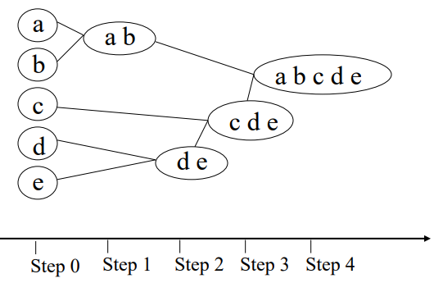
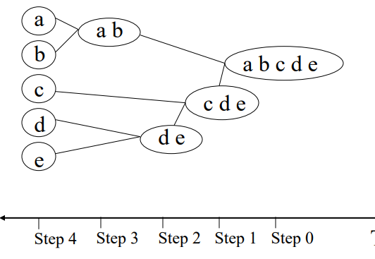
Side by side
Agglomerative approach
Divisive Approach

Slide 6
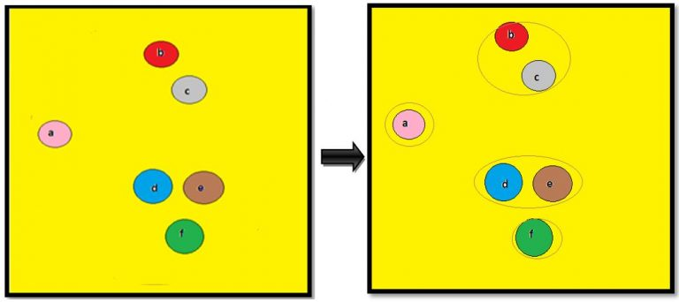
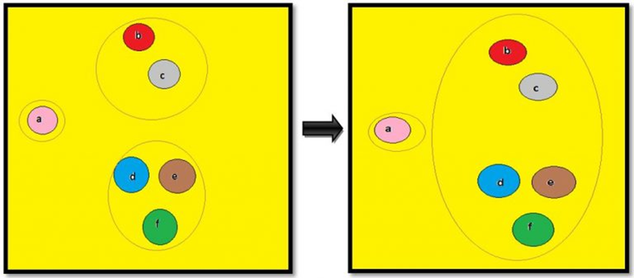
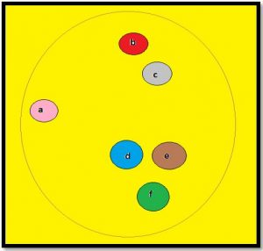
example
There are 6 samples
Cluster them based on some potential parameter like Euclidian distance.
points c and b can be grouped into one cluster and points d and e has another cluster.
points a and f as different individual clusters.
choose the midpoint of the longest branch as the threshold and hence we have 3 clusters.

Slide 7
limitation
The major limitation of agglomerative hierarchical clustering is that it is normally limited to data sets with fewer than 10,000 observations
the computational cost to generate the hierarchical tree can be high, especially for larger numbers of observations.

Slide 8
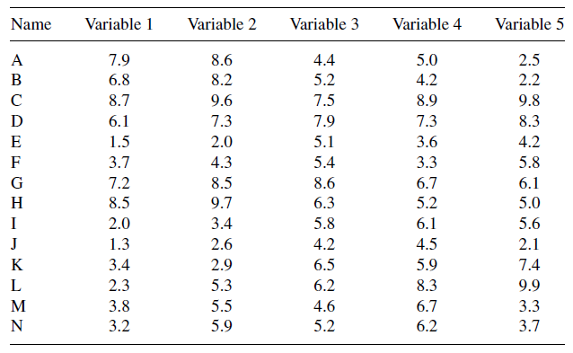
Sample data
data set of 14 observations measured & 5 variables
Variables are same scale
joining or linkage
rule is needed to determine the distance between an observation and a cluster of observations.

Slide 9
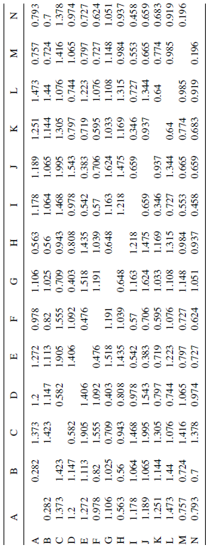
Distances between all pairs

Slide 10
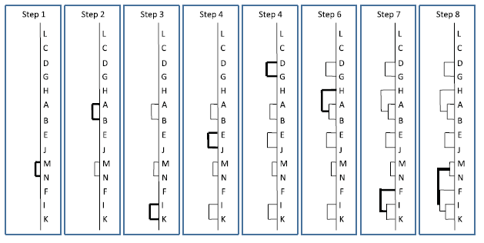
Tree formation steps

Slide 11
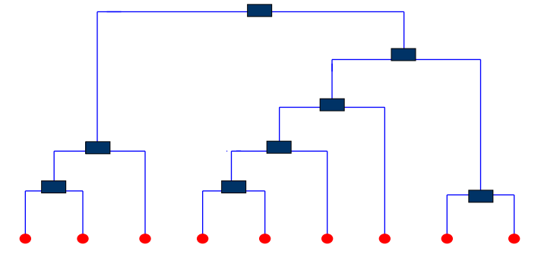
dendogram
When clustering completes, a tree called a dendrogram is generated
A tree that shows how clusters are merged/split hierarchically
Each node on the tree is a cluster; each leaf node is a singleton cluster

Slide 12
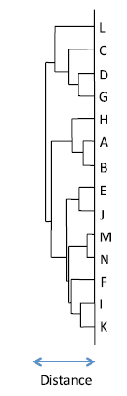
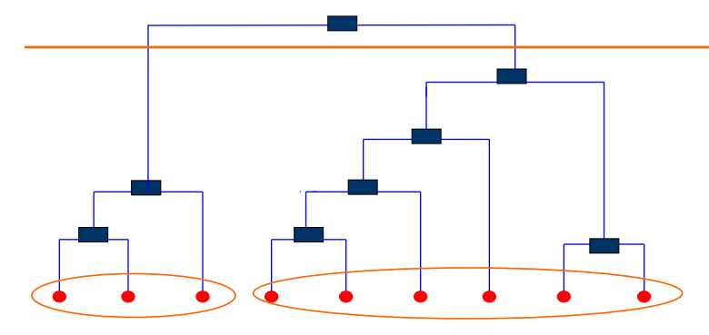
clustering
A clustering of the data objects is obtained by cutting the dendrogram at the desired level
To divide a data set into a series of distinct clusters, we must select a distance at which the clusters are to be created. Where this distance intersects with a horizontal line on the tree, a cluster is formed

Slide 13
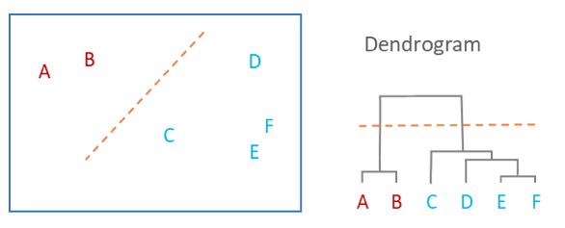
Example
Observations are allocated to clusters by drawing a horizontal line through the dendrogram.
Observations that are joined together below the line are in clusters.
In the example below, we have two clusters, one that combines A and B, and a second combining C, D, E, and F.

Slide 14
Linkage measures

Slide 15
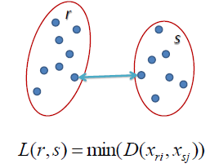
Single link
Single link distance is defined as the minimum distance between two points in each cluster.
Example: The distance between clusters “r” and “s” to the left is equal to the length of the arrow between their two closest points.
Determined by one pair of points, i.e., by one link in the proximity graph

Slide 16
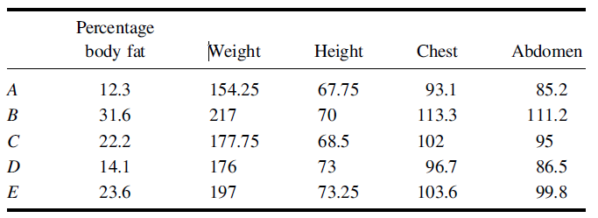
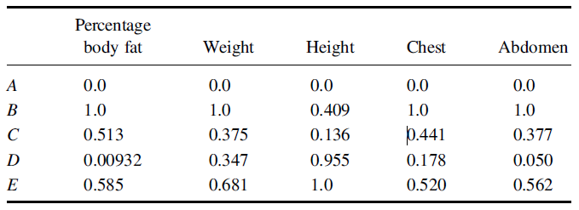
Example
Original Data
Normalized Data
5 observations: A, B, C, D, and E.
Each observation is measured over 5 variables: percentage body fat, weight, height, chest, and abdomen
First step - each observation is treated as a single cluster
next step is to compute a distance between each of these single-observation clusters
the Euclidean distance
single linkage agglomerative hierarchical clustering method joins pairs of clusters together based on the shortest distance between two groups
In practice, the single linkage approach is the least frequently used joining method

Slide 17
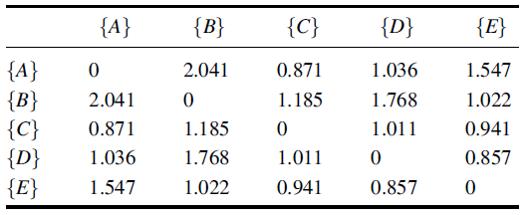
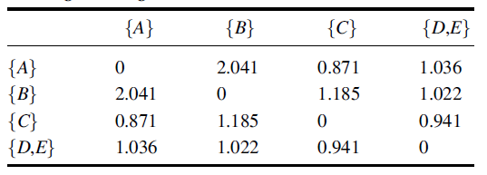
Distance matrix
Since the distance between {D} and {E} is the smallest, these single observation clusters are the first to be combined into a single group {D, E}
A new distance matrix is calculated for the 4 remaining clusters: {A}, {B}, {C} and {D, E}
In determining the distance between the new cluster {D, E} and the other clusters, the shortest distance is selected.
For example, distance between {B} and {D, E}
the distance between {B} and {D} is 1.768
the distance between {B} and {E} is 1.022
hence the distance between {B} and {D, E} is the smallest distance, or 1.022.

Slide 18
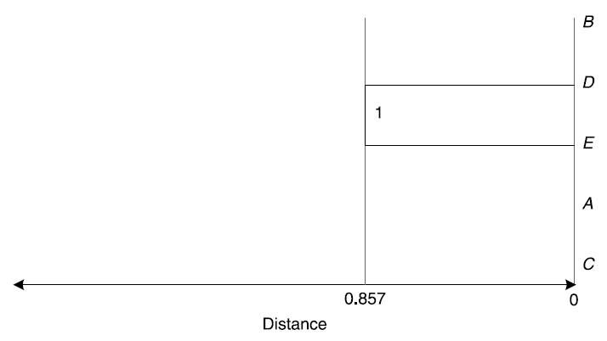
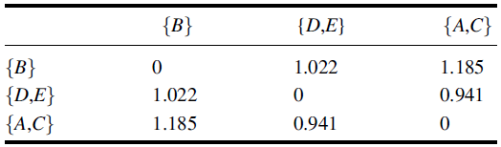
dendrogram construction
{D} and {E} initially combined, 2 observations are joined at 1
horizontal axes represent the distances at which the joining takes place
vertical line joining the 2 observations is at a distance of 0.857
Next, clusters {A} and {C} are combined
A new distance matrix is computed containing distances between the 3 remaining groups: {B}, {D, E} and {A, C}

Slide 19
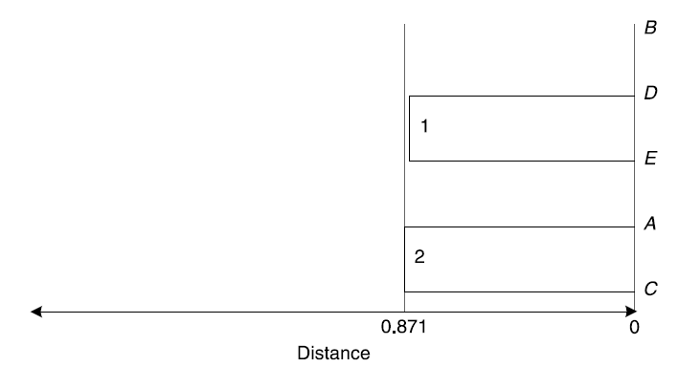
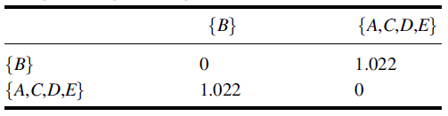
dendrogram construction
{A} and {C} combined, 2 observations are joined at 2
vertical line joining the 2 observations is at a distance of 0.871
Next, clusters {A, C} and {D, E} are combined
distance matrix for the remaining 2 groups, {B} and {A, C, D, E}

Slide 20
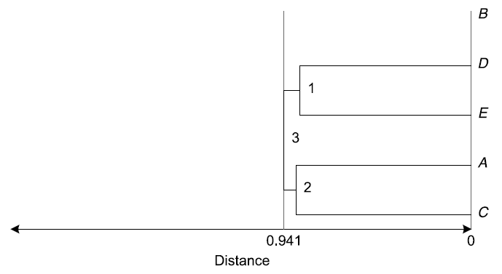
dendrogram construction
{A, C} and {D, E} combined, 2 clusters are joined at 3
vertical line joining the 2 clusters is at a distance of 0.941
distance matrix for the remaining 2 groups, {B} and {A, C, D, E}

Slide 21
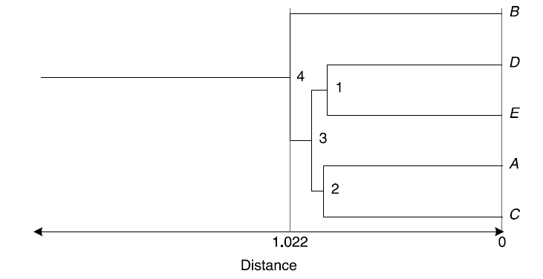
dendrogram construction
Groups {B} and {A,C,D,E} combined, 2 clusters are joined at 4
vertical line joining the 2 clusters is at a distance of 1.022
distance matrix for the remaining 2 groups, {B} and {A, C, D, E}

Slide 22
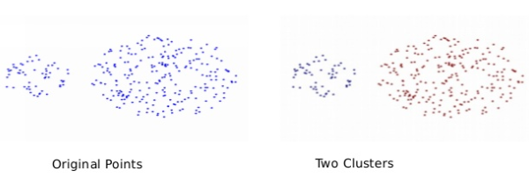
Single link
Advantages | Disadvantages
Can handle non-elliptical shapes. (long and tubular) | Sensitive to outliers and noise.
Produces long, elongated clusters.

Slide 23
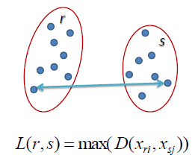
Complete link
Complete link distance is defined as the maximum distance between two points in each cluster.
Example: the distance between clusters “r” and “s” to the left is equal to the length of the arrow between their two furthest points.

Slide 24
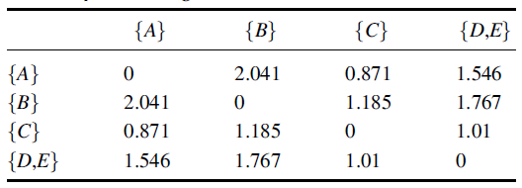
Distance matrix
1st step is similar to single linkage method
Since the distance between {D} and {E} is the smallest, these single observation clusters are the first to be combined into a single group {D, E}
A new distance matrix is calculated for the 4 remaining clusters: {A}, {B}, {C} and {D, E}
In determining the distance between the new cluster {D, E} and the other clusters, the maximum distance is selected.
For example, distance between {A} and {D, E}
the distance between {A} and {D} is 1.036
the distance between {B} and {E} is 1.547
hence the distance between {A} and {D, E} is the MAXIMUM distance, or 1.547

Slide 25
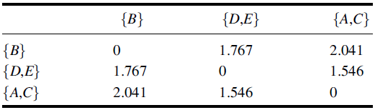
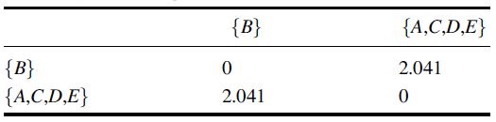
dendrogram construction
{D} and {E} initially combined, 2 observations are joined at 1
horizontal axes represent the distances at which the joining takes place
vertical line joining the 2 observations is at a distance of 0.857
Next, clusters {A} and {C} are combined
A new distance matrix is computed containing distances between the 3 remaining groups: {B}, {D, E} and {A, C}

Slide 26
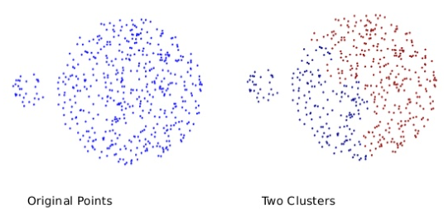
Complete link
Advantages | Disadvantages
Produces more balanced clusters (with equal diameter). | Small clusters are merged with large ones.
Less susceptible to noise.

Slide 27
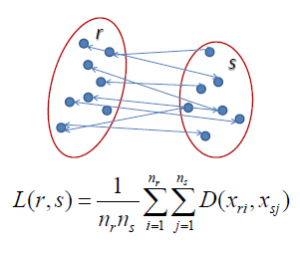
Average link
the average distance between each point in one cluster to every point in the other cluster.
Example the distance between clusters “r” and “s” to the left is equal to the average length each arrow between connecting the points of one cluster to the other.
Advantages | Disadvantages
Less susceptible to noise and outliers. | Biased towards globular clusters.

Slide 28
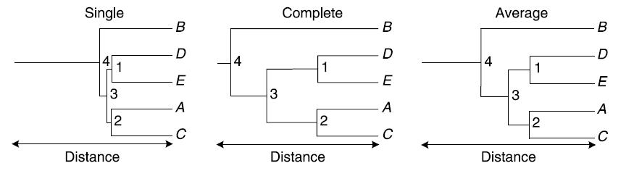
comparison

Slide 29
Centroid
distance between centroid rj of Cluster Cj and centroid rj of Cluster Cj
Advantages | Disadvantages
 | It suffers when there is more noise in the data.
 | Outliers can never be studied

Slide 30
wards
starts with each observation as a single cluster and progressively joins pairs of clusters until only one cluster remains containing all observations.
This method can operate either directly on the underlying data or on a distance matrix.
When operating directly on the data, the approach is limited to data with continuous values. At each step, Wards’s method uses a function to assess which two clusters to join.
This function attempts to identify the cluster which results in the least variation, and hence identifies the most homogeneous group.
The error sum of squares formula is used at each stage in the clustering process and is applied to all possible pairs of clusters.

Slide 31
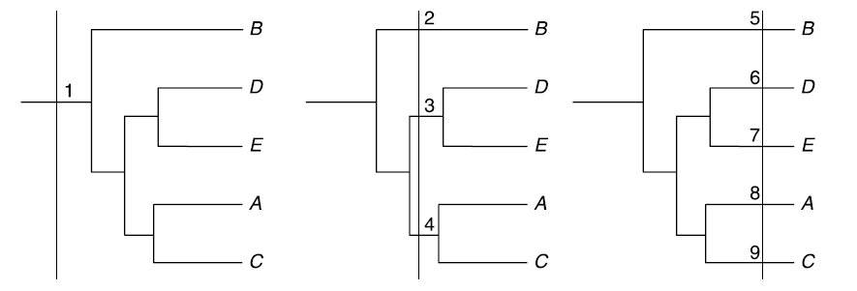
Selecting Groups
A dendrogram describing the relationships between all observations in a data set is useful for understanding the hierarchical relationships in the data.
In many situations, a discrete number of specific clusters is needed.
To convert the dendrogram to a series of groups, a distance at which the groups are to be formed should be specified.
Generating 1, 3, and 5 clusters at three different distance cut-offs
In the 1st dendrogram to the left, a large distance was selected. This results in the cut-off line dissecting the dendrogram at point 1. All children to the right of point 1 would be considered to belong to the same group, and hence only 1 group is generated in this scenario.
In the 2nd dendrogram in the middle, a lower distance cut-off value has been set, shown by the vertical line. This line dissects the dendrogram at points 2, 3, and 4, resulting in 3 clusters.
The 3rd dendrogram on the right has the lowest cut-off distance value

Slide 32
K Means and Hierarchical clustering
K Means | Hierarchical
K Means clustering can handle big data. time complexity of K Means is linear i.e. O(n) With a large number of variables, K-Means may be viewed as computationally faster than hierarchical clustering | Hierarchical clustering can’t handle big data. sets Time clustering for hierarchical clustering is quadratic i.e. O(n2)
start with an arbitrary choice of clusters
results generated by running the algorithm multiple times might differ | results are reproducible in Hierarchical clustering
work well when the shape of the clusters is hyper spherical (like circle in 2D, sphere in 3D). | Embedded flexibility concerning the extent of granularity.
Simple Fast for low dimensional data
K-Means will not identify outliers
K-Means is restricted to data which has the notion of a center (centroid)

Slide 33
scipy.cluster.hierarchy
These functions cut hierarchical clusterings into flat clusterings or find the roots of the forest formed by a cut by providing the flat cluster ids of each observation.
functions | Purpose
fcluster(Z, t[, criterion, depth, R, monocrit]) | Form flat clusters from the hierarchical clustering defined by the given linkage matrix.
fclusterdata | Cluster observation data using a given metric.
leaders | Return the root nodes in a hierarchical clustering

Slide 34
scipy.cluster.hierarchy
routines for agglomerative clustering
functions | Purpose
linkage(y[, method, metric, optimal_ordering]) | Perform hierarchical/agglomerative clustering.
single(y) | Perform single/min/nearest linkage on the condensed distance matrix y.
complete(y) | Perform complete/max/farthest point linkage on a condensed distance matrix.
average(y) | Perform average/UPGMA linkage on a condensed distance matrix.
weighted(y) | Perform weighted/WPGMA linkage on the condensed distance matrix.
centroid(y) | Perform centroid/UPGMC linkage.
median(y) | Perform median/WPGMC linkage.
ward (y) | Perform Ward’s linkage on a condensed distance matrix.

Slide 35
scipy.cluster.hierarchy
These routines compute statistics on hierarchies.
functions | Purpose
cophenet(Z[, Y]) | Calculate the cophenetic distances between each observation in the hierarchical clustering defined by the linkage Z.
from_mlab_linkage(Z) | Convert a linkage matrix generated by MATLAB(TM) to a new linkage matrix compatible with this module.
inconsistent(Z[, d]) | Calculate inconsistency statistics on a linkage matrix.
maxinconsts(Z, R) | Return the maximum inconsistency coefficient for each non-singleton cluster and its descendents.
maxdists(Z) | Return the maximum distance between any non-singleton cluster.
maxRstat(Z, R, i) | Return the maximum statistic for each non-singleton cluster and its descendents.
to_mlab_linkage(Z) | Convert a linkage matrix to a MATLAB(TM) compatible one.

Slide 36
scipy.cluster.hierarchy
Routines for visualizing flat clusters.
functions | Purpose
dendrogram(Z[, p, truncate_mode, …]) | Plot the hierarchical clustering as a dendrogram.

Slide 37
scipy.cluster.hierarchy
Routines for visualizing flat clusters.
functions | Purpose
dendrogram(Z[, p, truncate_mode, …]) | Plot the hierarchical clustering as a dendrogram.

Slide 38
scipy.cluster.hierarchy.inconsistent
Calculate inconsistency statistics on a linkage matrix.

Slide 39
Scikit learn implementation
class sklearn.cluster.AgglomerativeClustering(n_clusters=2, affinity=’euclidean’, memory=None, connectivity=None, compute_full_tree=’auto’, linkage=’ward’, pooling_func=’deprecated’)
n_clusters : int, default=2 - The number of clusters to find.
Affinity : string or callable, default: “euclidean” - Metric used to compute the linkage. Can be “euclidean”, “l1”, “l2”, “manhattan”, “cosine”, or ‘precomputed’. If linkage is “ward”, only “euclidean” is accepted.
linkage : {“ward”, “complete”, “average”, “single”}, optional (default=”ward”)
ward minimizes the variance of the clusters being merged.
average uses the average of the distances of each observation of the two sets.
complete or maximum linkage uses the maximum distances between all observations of the two sets.
single uses the minimum of the distances between all observations of the two sets.

Slide 40
Other slides

Slide 41
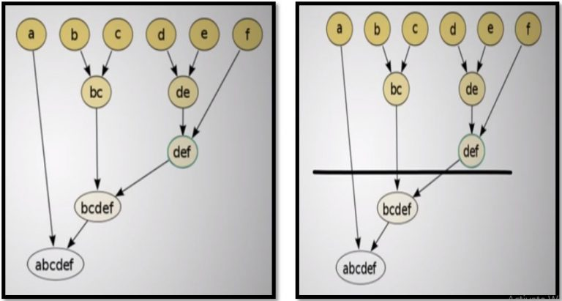
example

